Slide 1
Data Upgrade From 2012 to D365: Technical Process, Issues and Resolutions
Nathan Clouse

Slide 2

Nathan Clouse
www.atomicax.com
@NathanClouseAX
Technical Solution Architect Dynamic Consulting
AXUG Summit Track Leader 2018/19/20
Nathan.clouse@dynamicconsulting.com

Slide 3

Overview
Rip
AX 2012
Planning
Preparation
Cleaning
Prerequisites
Conditions
Execution
Tear
D365 F&O
Workspaces
Environments
Execution
Deep Dive
Verification
Until It Is Done

Slide 4
AX 2012

Slide 5
Planning
Where
AX 2012
PROD? UAT? Test?
A KB must be installed
D365 F&O
In Dev (T1) Environment?
In Cloud? Easier
Using on Prem VHD? Faster
UAT (T2+)
Cloud Only
New Feature as of PU33 (around a month ago)

Slide 6
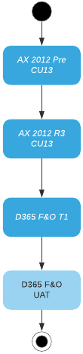
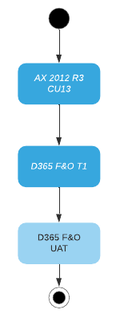
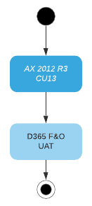
Planning
Notes:
Could be R2 CU9 or R3 CU13

Slide 7
Planning
When
After code has been upgraded to F&O If…
Same level of functionality and just upgrading to new version
Now If…
Expect major re-writes, changes or similar
Just want to see what issues there may be
Repeatedly
Initial set of upgrades to identify and address issues
Recommend at least 5 times
Lock in process as best you can for go live

Slide 8
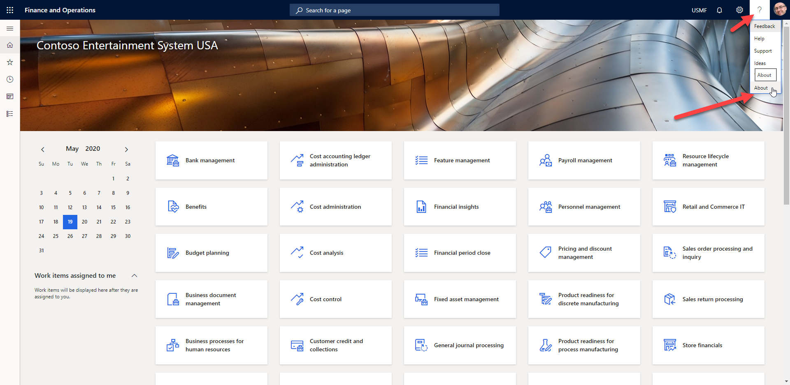
Planning

Slide 9
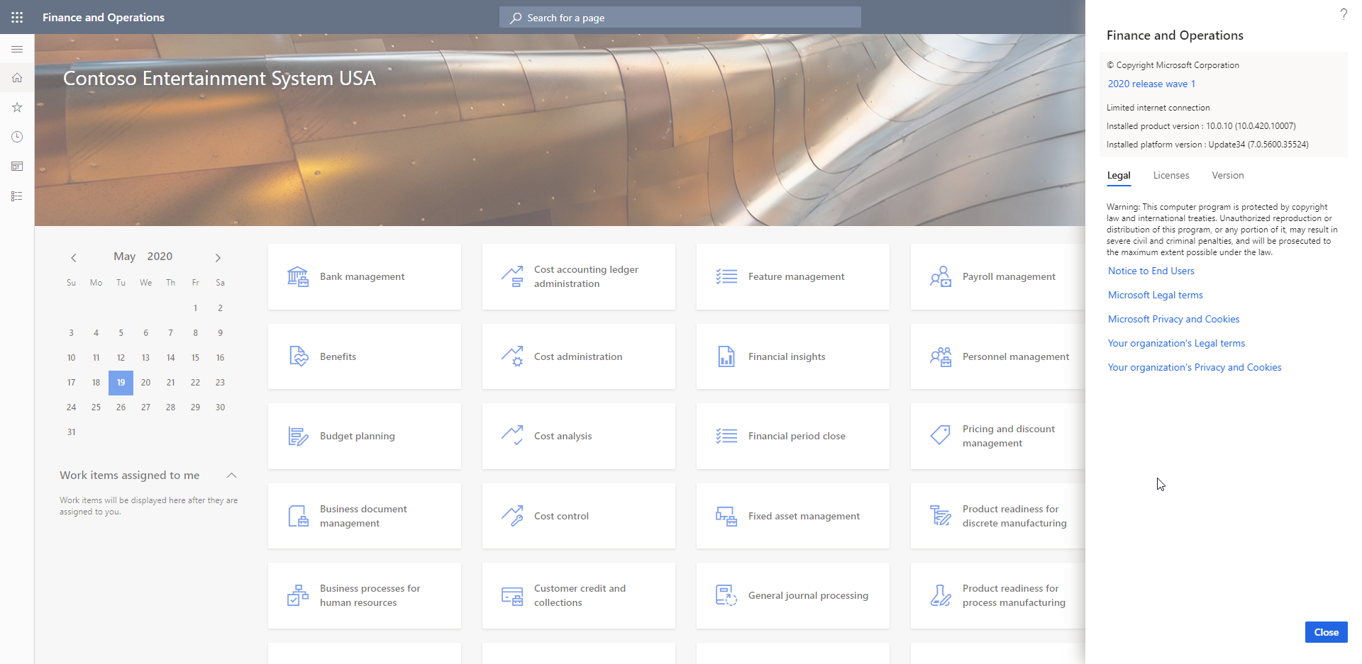
Planning
Application
Kernel

Slide 10
Planning
How
Process is like AX 2009 to AX 2012 upgrade, if you’ve done that
Install AX 2012 KB
Run Prep
Backup AX 2012 Database and restore in D365 FO Environment with upgraded code
Run database upgrade package
MyTable.MyField in AX 2012 automagically maps to MyTable.MyField in F&O.
Any other data requires a data upgrade script

Slide 11
Pre-Execution
Prepare
Remove Unneeded / Unused ISVs
Before upgrade? During Upgrade?
Keep any Data?
Create Inventory of Customizations if you don’t have one
Know what is going to be upgrade and what isn’t
Have plan to upgrade data related to those customization
Remove Customizations not in use, if possible
Indexes
Can only add new ones now
Can’t change existing indexes

Slide 12
Pre-Execution
Clean
Run Cleanup Procedures
https://docs.microsoft.com/en-us/archive/blogs/axsa/cleanup-routines-in-dynamics-365-for-finance-and-operations
http://www.atomicax.com/article/full-database-cleanup-routine-part-1
Use database consistency check
System administration > Periodic > Database > Consistency check
Review Results using check option
Test / Review using fix option
Use by module / sub module

Slide 13

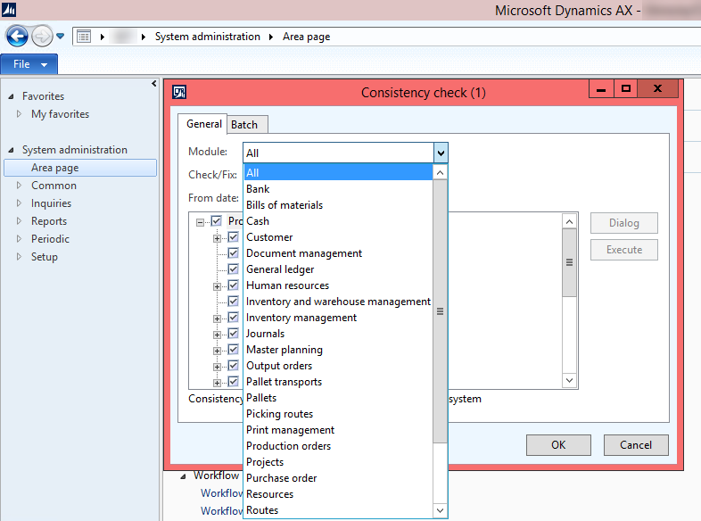
Consistency Check - Overview
The
Cost
of Progress

Slide 14
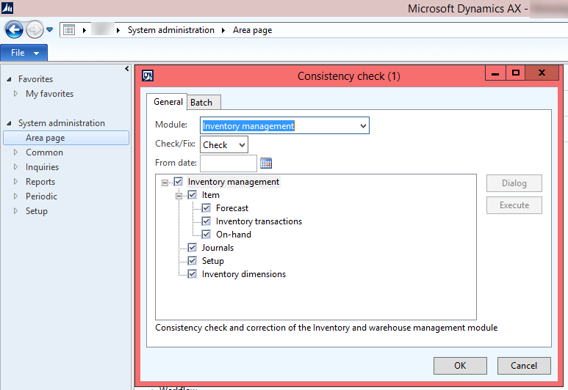
Consistency Check - Module

Slide 15
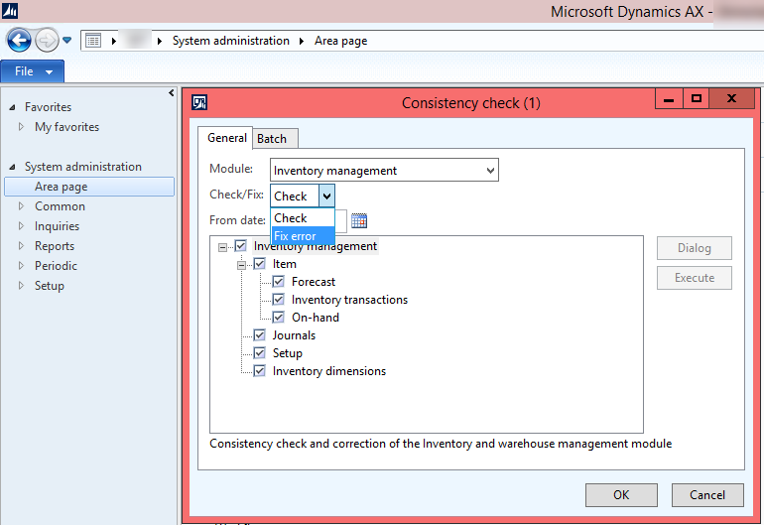
Consistency Checks – Check/Fix

Slide 16
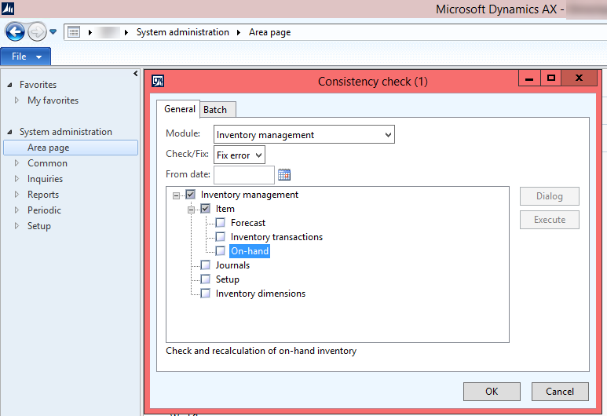
Consistency Checks

Slide 17
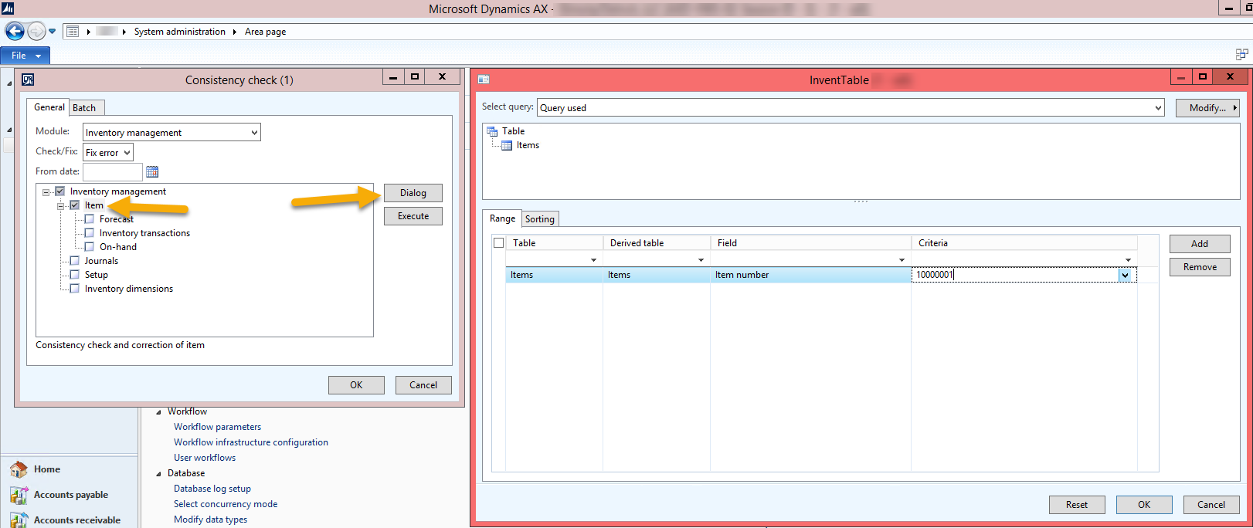
Consistency Checks

Slide 18
Pre-Execution
Specific Versions
AX 2012 R3 CU13
AX 2012 R2 CU9
Installed KBs
R3 – 4035163
R2 – 4048614
Come with some extra stuff packaged into the KB
Other Options?

Slide 19
Execution
Install KB for your version
Start in 2012 Dev environment
Analyze fallout, make appropriate changes
Prepare to roll out to Test/UAT, PROD, any other environments (may require code changes for customizations)
Compile, CIL Compile
Obtain database backup from PROD
Restore into Dev environment, run appropriate scripts for back
Upgrade database (If Required), Sync
Run Pre-upgrade check list (System Administration > Setup > Checklists )

Slide 20
Execution
Run Pre-upgrade check list
Prepare model metadata
Prepare security role metadata
Setup user mapping
Converts from using local Active directory to use Azure Active directory
Will need users AAD login username; Contoso\SallyM vs SallyM@Contoso.com
Validate baseline version
Archive retail salt data
https://docs.microsoft.com/en-us/dynamics365/fin-ops-core/dev-itpro/migration-upgrade/prepare-data-upgrade

Slide 21
Last Step For T1
Backup prepared 2012 Database
Export as .bak file
Ideal if AOS(s) are stopped at time of export but not required for iteration testing process
Upload to Cloud Storage
SharePoint
OneDrive
LCS
Anywhere Secure

Slide 22
Last Step for T2 and Above
Make copy of AX 2012 Database
https://docs.microsoft.com/en-us/dynamics365/fin-ops-core/dev-itpro/migration-upgrade/upgrade-data-sandbox#run-the-t-sql-script-to-prepare-the-database
Run preparation SQL
https://docs.microsoft.com/en-us/dynamics365/fin-ops-core/dev-itpro/migration-upgrade/upgrade-data-sandbox#run-the-t-sql-script-to-prepare-the-database
Export as Bacpac
https://docs.microsoft.com/en-us/dynamics365/fin-ops-core/dev-itpro/migration-upgrade/upgrade-data-sandbox#export-the-copied-database-to-a-bacpac-file

Slide 23
Final Step for T2 and Above
Export as Bacpac
https://docs.microsoft.com/en-us/dynamics365/fin-ops-core/dev-itpro/migration-upgrade/upgrade-data-sandbox#export-the-copied-database-to-a-bacpac-file
Upload to LCS

Slide 24
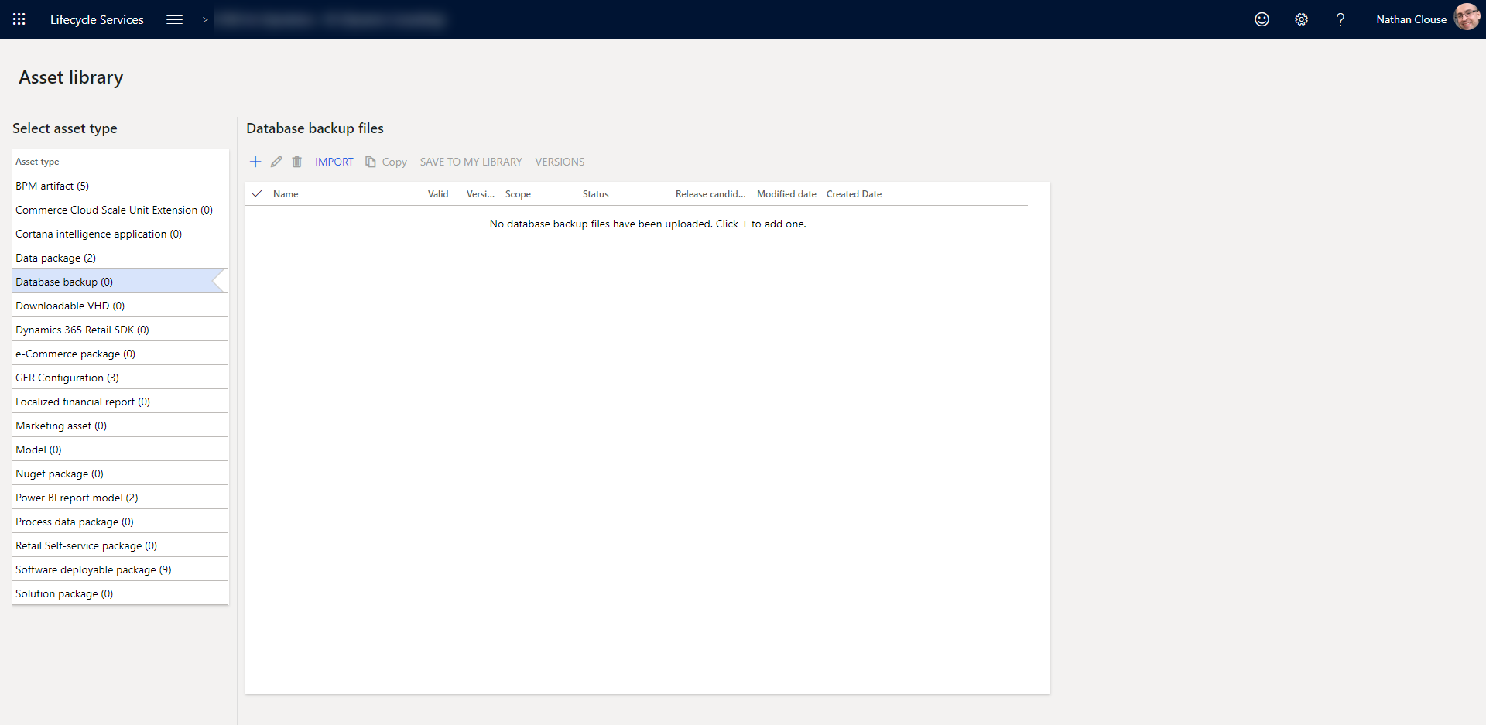
Upload to LCS

Slide 25
D365 F&O

Slide 26
Planning
Have F&O Setup
Demo Environment
Database Upgrade environment
Environment not use for active development
Should be connected to source control for updates between iterations
T1 Cloud is where we’ll focus
T2 option available for a refined database upgrade process

Slide 27
Planning
Choose Wisely
Pick the version of the upgrade package that is available and build environments to that version
Cannot mix and match
Upgrade Package is built to a specific version
Only works for that version

Slide 28
Planning
10.0.10
10.0.10 (10.0.420.10007)
10.0.10
10.0.10 (10.0.420.10007)

Slide 29
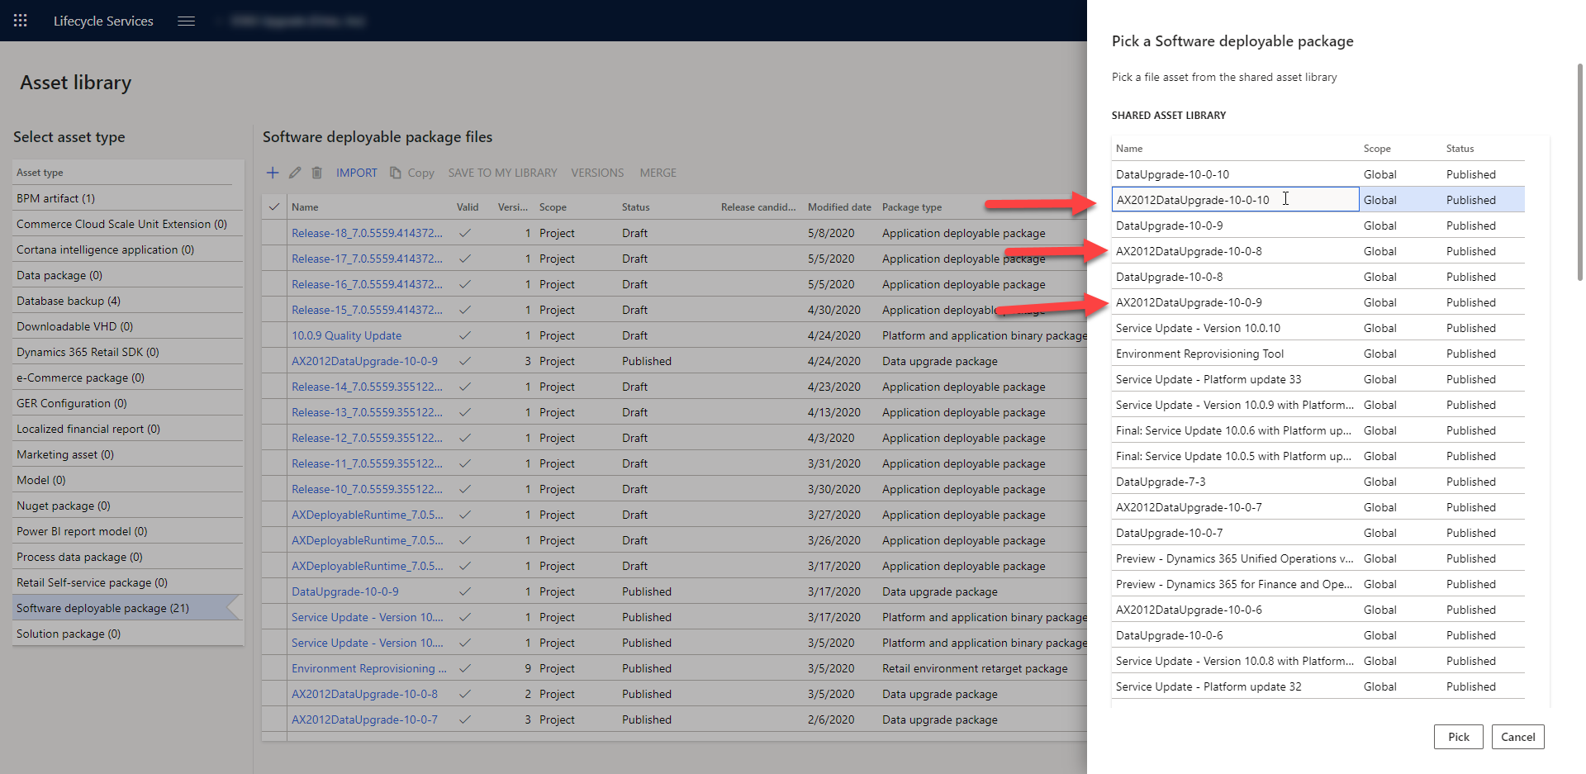

Slide 30
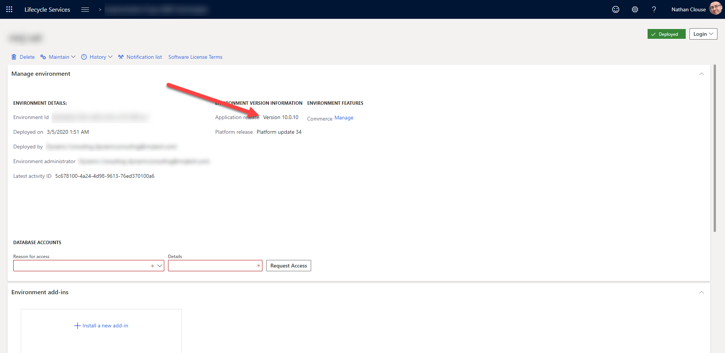

Slide 31
Planning
Use D365FO.Tools?
Find issues
Code Related
Missing upgrade scripts
Bugs
Database Related
Structure different
Different constraints in database
Data Issues
Bad Data
Remember all the direct SQL queries that weren’t SELECTs…

Slide 32
Execution
Import AX 2012 Database D365 Dev environment
Stop Management Reporter 2012 Process Service
Stop Microsoft Dynamics 365 Unified Operations: Batch Management Service
Stop World Wide Web Publishing Service
D365FO.Tools
Stop-D365Environment -All
Start-D365Environment -All
Make sure Dev environment has the latest code, it builds and syncs

Slide 33
Execution
Run deployable package to do the data upgrade selected earlier
Known Issues: https://docs.microsoft.com/en-us/dynamics365/fin-ops-core/dev-itpro/migration-upgrade/upgrade-data-to-latest-update#known-issues
Two Options
LCS
Local Package

Slide 34
Using LCS
Easiest option
Lots of failures means lots of emails
Not recommended for a first few attempts
Better suited for later in the project
Process
Restore database
Apply package from LCS
Get lots of emails

Slide 35
Using Local Package
Download to VM from LCS manually
Unblock and unzip ( into working directory )
Command Line tools from MSFT available
D365FO.Tools is a community set of PowerShell tools that improves on what MSFT offers
Use of D365FO.Tools is highly recommended. We’ll be using this in our examples
Install-Module -Name d365fo.tools

Slide 36
Quick Install - RunAll
Create Topology XML from current environment. Using default runbook id 'Runbook' and run all the operations from generate, to import to execute.
Only usable once per machine*
Invoke-D365SDPInstall -Path "c:\temp\" -Command RunAll

Slide 37
Advanced
You set the RunBook ID
Repeatable using the same machine
Additional commands but worth a little extra work

Slide 38
Set Topology
Automatically detects the installed components on the machines
Invoke-D365SDPInstall -Path "C:\temp\MajorVersionDataUpgradePackage" -Command SetTopology

Slide 39
Generate Runbook
Creates the set of steps to be executed by the package based on the topology
Invoke-D365SDPInstall -Path "C:\temp\MajorVersionDataUpgradePackage" -Command Generate -RunbookId 'MyRunbook1'

Slide 40
Import Runbook
Simply Imports the Runbook
Invoke-D365SDPInstall -Path "C:\temp\MajorVersionDataUpgradePackage" -Command Import -RunbookId 'MyRunbook1'

Slide 41
Execute Runbook
Kicks off the upgrade
Invoke-D365SDPInstall -Path "C:\temp\MajorVersionDataUpgradePackage" -Command Execute -RunbookId 'MyRunbook1'

Slide 42
Execution Suggestions
Use unique Runbook IDs tied Azure DevOps work items
Report issues, bugs, and resolutions on that work item with references to other work items
Create follow up tasks related to that Runbook execution work item
Could use Iterations if you want
Lots of options to keep PMs happy

Slide 43
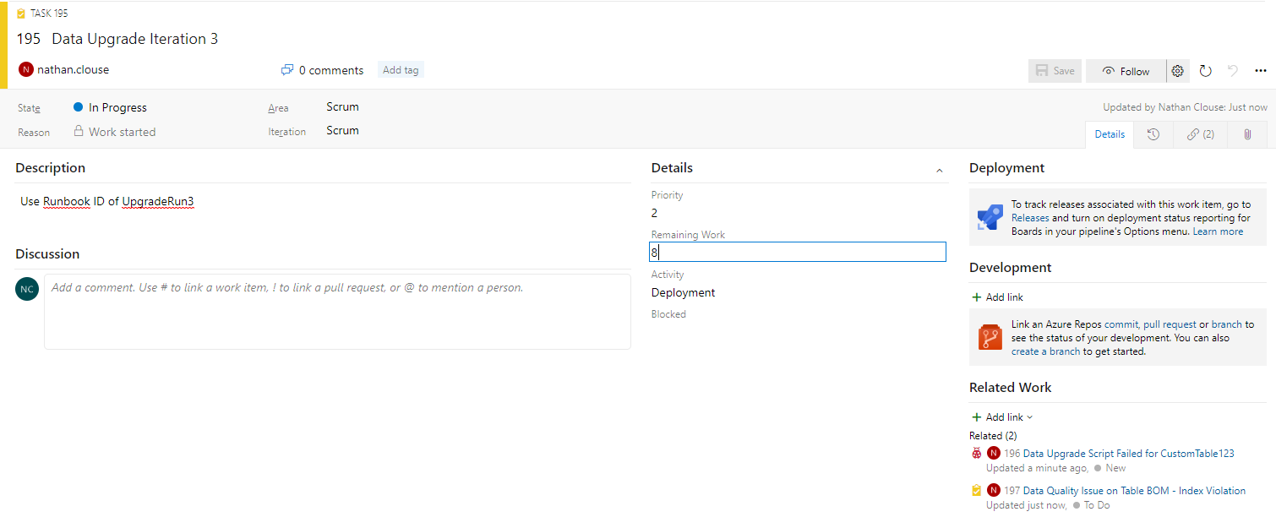
Example

Slide 44
Re-Run Failed Steps
If one step fails, the whole upgrade fails
If one operation fails, that fails the step
If one table change fails, the operation fails
If one record fails, that table change fails
Invoke-D365SDPInstall -Path "C:\temp\MajorVersionDataUpgradePackage" -Command RerunStep -Step 8 -RunbookId 'MyRunbook1'

Slide 45
Deep Dive Into the Runbook
Focus on the T1 / Development environment experience
Using D365FO.Tools
Logs
Logs can be found in C:\Temp\MajorVersionDataUpgradePackage\RunbookWorkingFolder\MyRunbook42\Contoso-DBU-1\
Get-Content –wait <log file>
Just like tail -f

Slide 46
Runbook Steps; 1, 2, 3, 4
1 - Stop Retails Services
2 - Stop Financial Report
3 - Stop AOS Service and batch service
4 - Backup some configs related to the AOS Services

Slide 47
Runbook Step; 5
5 - Run some Prerequisites, make sure we are upgrading from a known version and state, add in some 365 system tables so that batch service can run properly against database
Create or Adjust SQL Sequences for RecId (sequences are now SQL sequences)
All tables should be altered - Now RecId creation should take next value from SQL Sequences.

Slide 48
Runbook Step; 5 (cont.)
Patch SQLDICTIONARY table - For two fields Name and SQLNAME, str size increased from 40 to 81.
Patch USERINFO table - ID field str size increased from 8 to 20, Fix time zone error.
Update USERINFO table records to help running data upgrade and launching AX. (makes network service the default instance admin)
Clear out Tables that store Major Version dependent data. (truncate sysLastvalue)

Slide 49
Runbook Step; 6
6 - Cleanup for data upgrade
Delete from releaseUpdateScripts, releaseUpdateScriptDependency, releaseUpdateJobStatus, releaseUpdateScriptsUsedTables, releaseUpdateDiscoveryStatus
Delete all batch jobs related to database upgrade, if any, including from past database upgrades
Delete from ReleaseUpdateScriptsLog and ReleaseUpdateScriptsErrorLog

Slide 50
Runbook Step; 7
7 - Presync for data upgrade
Enable SysDeletedObjects config keys
Save current batch configuration
Disable BatchPriorityBasedSchedulingFeature if necessary; only if platform version is PU32 or later
Start batch service
Assign Upgrade Batch Group to Batch Servers (current AOS)
Schedule presync script which will invoke all presync type scripts
Script waits until batch completes with all presyncs executing completely and correctly
if error, stop batch, upgrade stops and reports log output

Slide 51

Runbook Step; 8
8 – Sync Database for all versions
Runs database sync, ignoring indexes
Enables all fields that were ever available from 6.2, 6.3, 7.0, 7.1, 7.2, 7.3, 8.0, 8.1, 8.2, and 10.+.

Slide 52
Runbook Step; 9
9 - Post sync for upgrade
Schedules postSync scripts
Schedules all postSync type scripts
Assign Upgrade Batch Group to Batch Servers (current AOS)
Start batch service
scripts waits until batch completes with all postSync executing

Slide 53
Runbook Step; 9 (cont.)
If error, stop batch, upgrade stops and reports log output
Disable SysDeletedObjects config keys for 7.0, 7.1, 7.2, 7.3, 8.0, 8.1, 8.2
Stop batch service
Enable BatchPriorityBasedSchedulingFeature if necessary; only if platform version is PU32 or later
Restore batch configuration

Slide 54

Runbook Step; 10
10 - Final DB sync
Remove deprecated fields from SysDeletedObjects config keys
Basically a standard database sync to organize the database into final known good configuration for D365

Slide 55
Runbook Step; 11 - 13
11 – Warns to backup Financial Report database
12 – Update Financial Reporter database
Update schema user privilege data
Insert AAD Group API related settings
Execute SQL query to update AX adapter setting value
Add ReportingIntegrationUser Role to AX DB, provision GeneralUser on MR DB
Setup change tracking on MR database
Upgrade / Rebuild data mata
13 – Warns to backup retail configs and data

Slide 56
Runbook Step; 14 - 17
14 – Upgrade retail
Upgrades / Redeploys channel DB
Upgrades Message DB
15 – Start AOS
16 – Start Financial Reporter
17 – Start Retail Services

Slide 57

Troubleshooting
Skip Failed Scripts
Can help identify more errors than just the first one that fails an upgrade
https://docs.microsoft.com/en-us/dynamics365/fin-ops-core/dev-itpro/migration-upgrade/upgrade-data-to-latest-update#skip-failed-scripts
Known Issues
https://docs.microsoft.com/en-us/dynamics365/fin-ops-core/dev-itpro/migration-upgrade/upgrade-data-to-latest-update#known-issues

Slide 58
Troubleshooting
Check LCS
Some errors are version dependent so you may have to start with a different version
May be fix in quality update
Some weirdness may be ok
Solve problems pragmatically

Slide 59
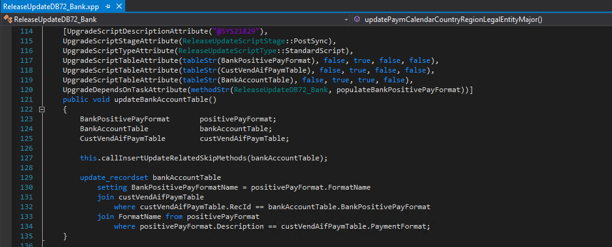
Troubleshooting - Updates

Slide 60
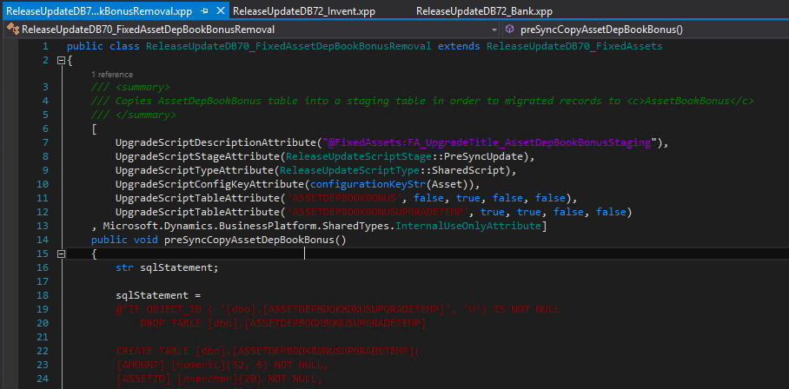
Troubleshooting – Presync Update

Slide 61
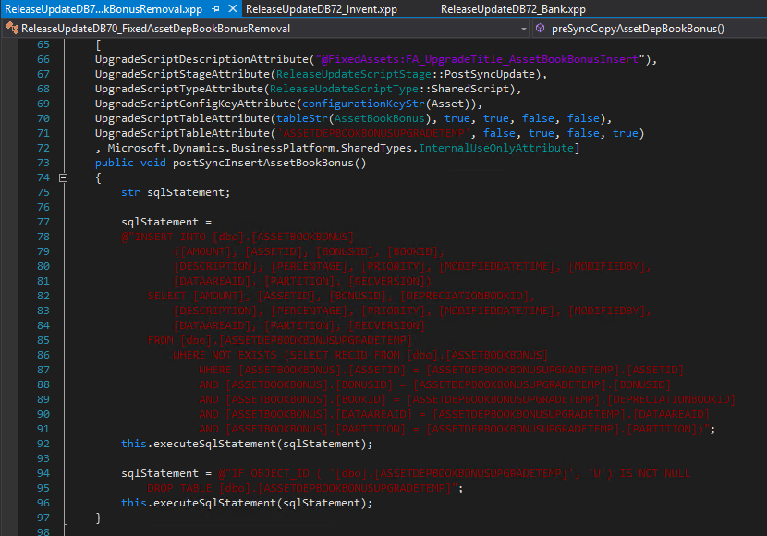
Troubleshooting – PostSync Insert

Slide 62
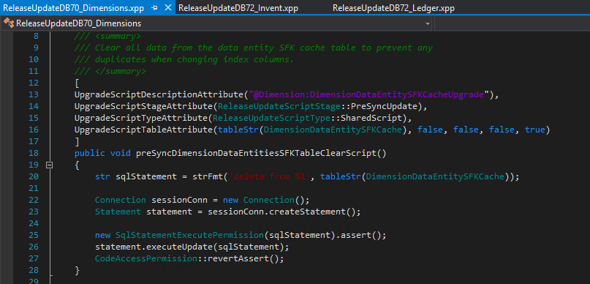
Troubleshooting - Delete

Slide 63
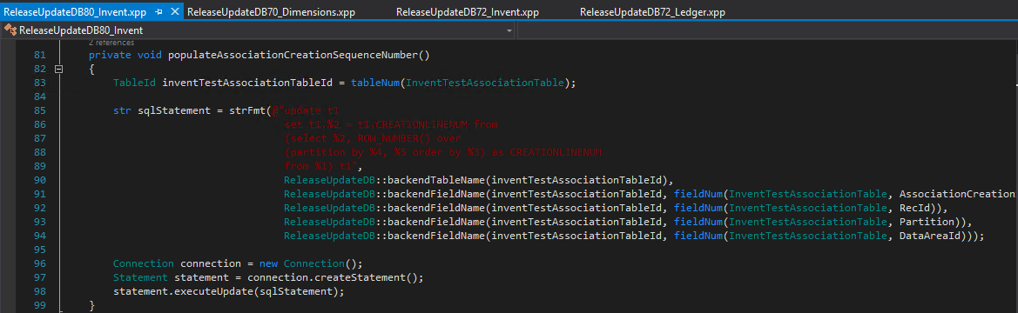
Troubleshooting – SQL Functions

Slide 64
Logging
The Runbook will have a folder where everything gets logged
C:\Temp\MajorVersionDataUpgradePackage\RunbookWorkingFolder\MyRunbook42\Contoso-DBU-1\AOSService\8\Log
Temp Directory – C:\Temp
Deployable Package – MajorVersionDataUpgradePackage
MyRunBook42 – Runbook ID generated for this iteration
Contoso-DBU-1 – Machine DNS name
8 – Runbook Step id
Get-Content –Wait FullDBSync.log

Slide 65
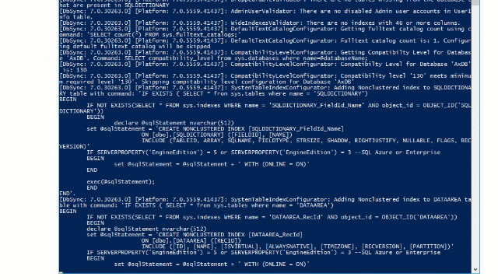
Logging (cont.)

Slide 66
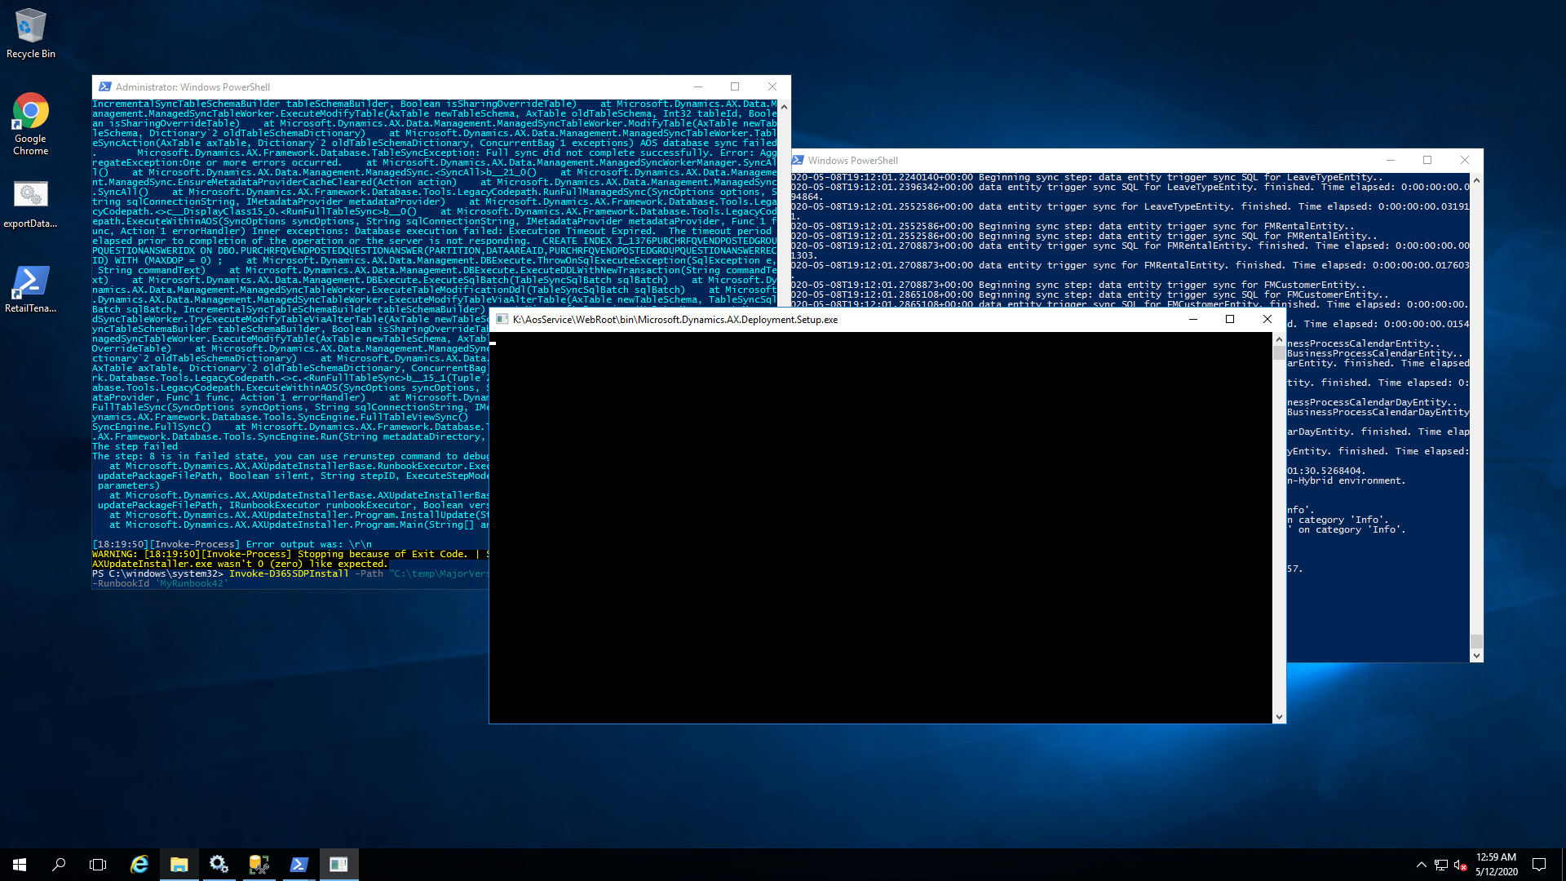
Logging (cont.)

Slide 67
Verification - Cardinality
In 2012, I started with X customers, vendors, items, SOs, PO, posted GL journals, Fixed assets, Production Orders, Main Accounts
Identify key areas for each legal entity and measure the counts for each system: 2012 vs 365
Exporting values on screen to excel from both systems
Use Data Entities in 365 to export the same data to compare to exported from 365 screens as well as 2012 screens

Slide 68
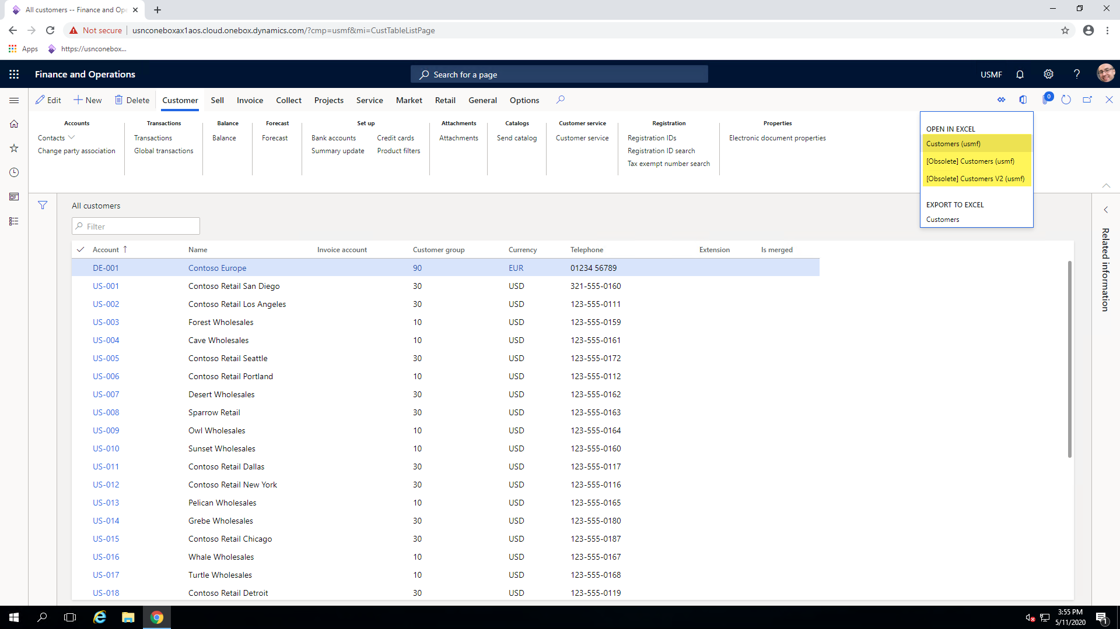
List Pages and Entities

Slide 69
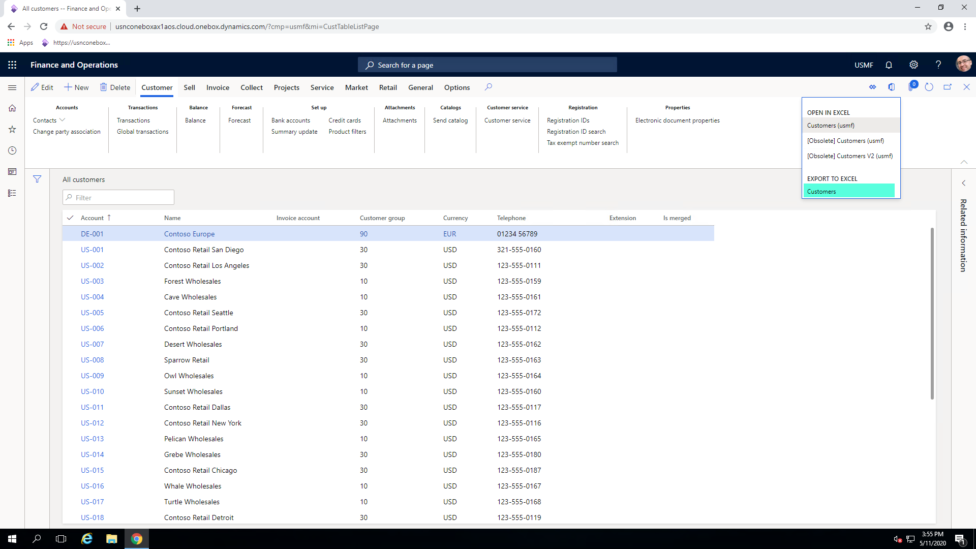
List Pages and Entities

Slide 70
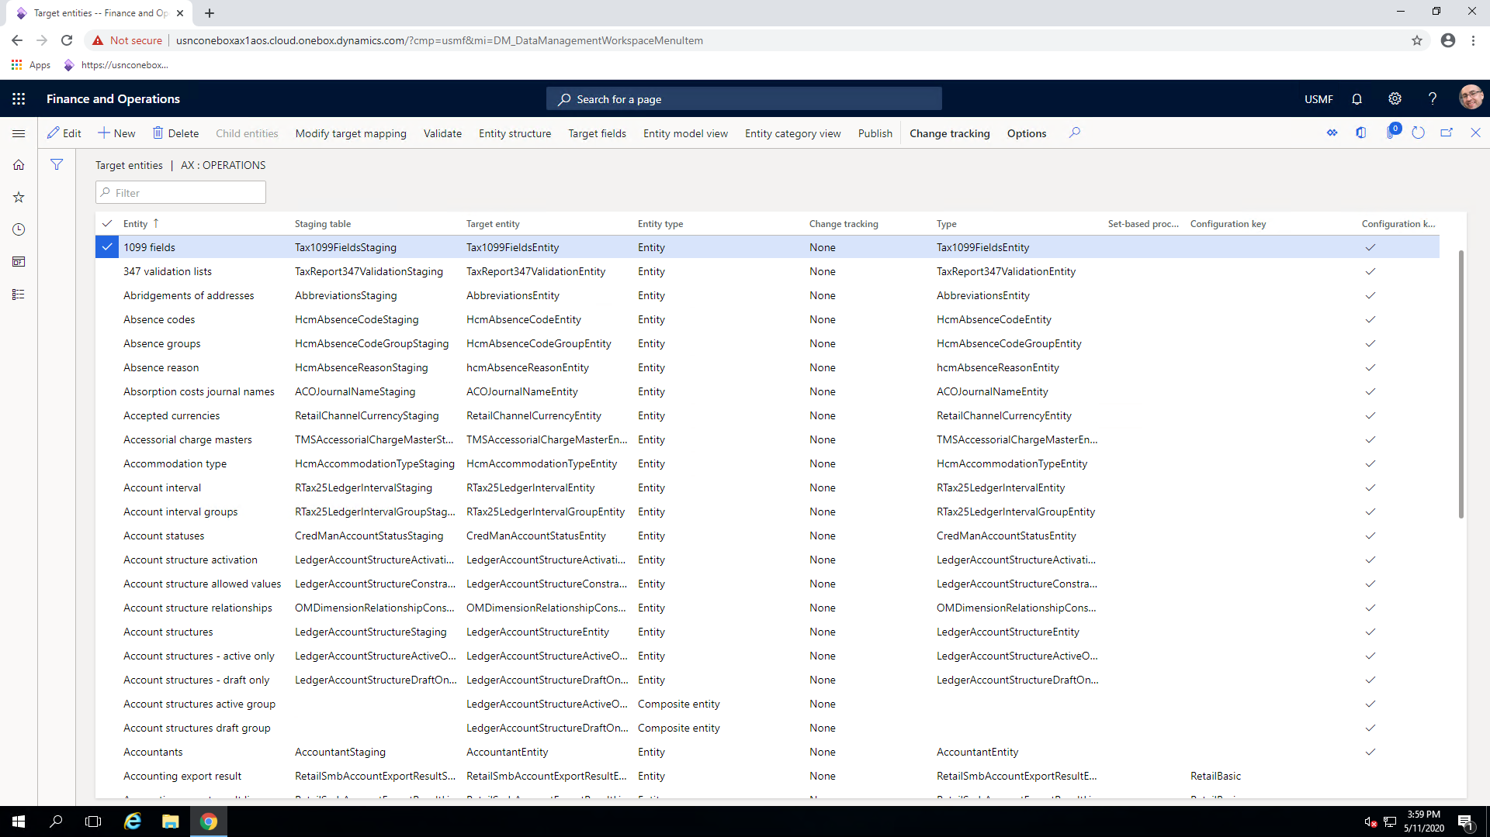
Data Entities

Slide 71
Verification – Summation
Do my account balances match?
AX 2012: General Ledger > Reports > Transactions > Dimension Statement
F&O: General Ledger > Inquiries and Reports > Ledger Reports > Dimension Statement
What about transaction Balances?
General Ledger > Common > Accounting Source Explorer
F&O: General Ledger > Inquiries and Reports > Accounting Source Explorer

Slide 72
Verification – Summation
Does my trial balance match?
AX 2012: General Ledger > Common > Trial Balance
F&O: General Ledger > Inquiries and Reports > Ledger Reports > Trial Balance
Do my Management Reporter / Finance Reports match?

Slide 73
Closing Out
Adding users (back) from outside the organization
For each company, re-setup print management settings
Visit Finance Reporting Setup form and review
Document Management
Print Management
Retail / Commerce
Review Stores and POS setup
Review scheduler and channel database setups

Slide 74
Closing Out
Capacity Synchronization
Project management and accounting > Inquiries and reports > Capacity synchronization
Intercompany: Project management and accounting > Setup > Posting > Ledger posting setup
Budgeting
Budgeting > Setup > Budget planning > Budget planning configuration
Columns and Layouts

Slide 75

Ready Go Live
Run 2012 Upgrade Checklist (if possible)
Stop 2012 AOSs
Get 2012 Database Backup
May we never need you again

Slide 76
Ready To Go Live – 3 hops
Stop PROD 2012 AOSs
Get PROD 2012 Database Backup
Restore in environment with KB
Sync DB
Run 2012 Database Upgrade
Run 2012 Upgrade Checklist
Stop AOS
Get 2012 Database Backup from environment with KB
Restore in F&O T1 Environment
Run F&O Database Upgrade
Run Verifications
Export as bacpac
Upload to LCS
Restore in UAT
Verify again with users
Backup from LCS
Request Restore in PROD

Slide 77
Ready To Go Live – 2 hops
Run 2012 Upgrade Checklist
Stop 2012 AOSs
Get 2012 Database Backup
Restore in F&O T1 Environment
Run F&O Database Upgrade
Run Verifications
Export as bacpac
Upload to LCS
Restore in UAT
Verify again
Backup with LCS
Request Restore in PROD

Slide 78
Ready To Go Live – 1 hop
Run 2012 Upgrade Checklist
Stop 2012 AOSs
Get 2012 Database Backup as bacpac
Upload to LCS
Restore Database in UAT
Deploy Database upgrade package
Verify
Request Restore in PROD

Slide 79

Questions?

Slide 80


